Slide 1


Predictive Analytics Lab Project
Title:
Predictive Analysis Of Music Theory On Mental Health
R2142220130: Pranit Abraham Thomas
R2142220136: Pushp Prakhar Bhardwaj
Mentored By:
Ms. Achala Shakya

Slide 2
Abstract
This project explores the intricate relationship between music preferences and mental health outcomes using predictive modeling. By analyzing a diverse dataset containing psychological parameters such as Conscientiousness, Neuroticism, Extraversion, and K-10 scores, the model uncovers patterns that connect musical choices with mental well-being.
With an emphasis on ethical considerations, this project utilizes anonymized, publicly available datasets to ensure privacy. Our findings aim to enhance understanding of the emotional and cognitive impacts of music, offering valuable applications in mental health analytics and personalized interventions.
Notes:
The technical concepts used in out project are:
1. Centralized Platform for Relief Aid Management
The system brings all relief requests into one platform, ensuring that aid efforts are well-coordinated without duplication.
By managing resources centrally, it allows for an efficient allocation of supplies to the most critical areas.
Real-time tracking of aid requests and deliveries helps decision-makers stay informed about the current status and adjust responses swiftly based on needs.
2. Database Management
A structured database stores important information such as aid requests, available supplies, and driver details to streamline relief efforts.
Real-time updates ensure that changes, like new requests or fulfilled deliveries, are reflected immediately, minimizing confusion and delays.
Security measures are in place to protect sensitive data, ensuring only authorized personnel can access or modify critical information.
3. Geographic Zoning for Requests
Disaster areas are divided into geographic zones, making it easier to manage resources and track the delivery of aid.
Drivers and volunteers are assigned specific zones, which helps prevent overlap and ensures faster aid distribution to the areas most in need.
The system also optimizes delivery routes based on real-time data, reducing travel time and enabling more efficient use of resources.
summarize the content try to mearge similar points and make It more straight forward

Slide 3
Introduction
Technical Concepts used
The technical concepts used in our project are:
1. Machine Learning Algorithms
XGBoost: Gradient-boosted decision tree algorithm for robust and efficient predictions.
Random Forest: Ensemble method used for classification and regression tasks.
Linear Regression: Statistical method for modeling relationships between variables.
2. Data Preprocessing
Data Cleaning: Handling missing, inconsistent, or noisy data for better model performance.
Feature Engineering: Extracting relevant features like personality traits (Openness, Conscientiousness, Neuroticism) and mental health indicators (K-10 scores).
Normalization and Scaling: Ensuring all features are on a comparable scale for accurate modeling.
3. Psychological and Personality Metrics
Incorporation of the Big Five Personality Traits (Openness, Conscientiousness, Extraversion, Agreeableness, Neuroticism).
Use of K-10 Mental Health Scale to measure psychological distress levels.
Notes:
The technical concepts used in out project are:
1. Centralized Platform for Relief Aid Management
The system brings all relief requests into one platform, ensuring that aid efforts are well-coordinated without duplication.
By managing resources centrally, it allows for an efficient allocation of supplies to the most critical areas.
Real-time tracking of aid requests and deliveries helps decision-makers stay informed about the current status and adjust responses swiftly based on needs.
2. Database Management
A structured database stores important information such as aid requests, available supplies, and driver details to streamline relief efforts.
Real-time updates ensure that changes, like new requests or fulfilled deliveries, are reflected immediately, minimizing confusion and delays.
Security measures are in place to protect sensitive data, ensuring only authorized personnel can access or modify critical information.
3. Geographic Zoning for Requests
Disaster areas are divided into geographic zones, making it easier to manage resources and track the delivery of aid.
Drivers and volunteers are assigned specific zones, which helps prevent overlap and ensures faster aid distribution to the areas most in need.
The system also optimizes delivery routes based on real-time data, reducing travel time and enabling more efficient use of resources.
summarize the content try to mearge similar points and make It more straight forward

Slide 4
Introduction
Motivation
Music is a universal language that profoundly impacts human emotions, cognition, and mental well-being. However, the extent to which music preferences influence mental health remains underexplored. This project was inspired by the following key motivations:
Rising Mental Health Concerns
With increasing awareness of mental health issues worldwide, understanding unconventional yet impactful factors like music becomes crucial for innovative solutions.
Personalized Mental Health Insights
Music, being deeply personal, has the potential to offer tailored therapeutic benefits. By analyzing individual music preferences, this project aims to provide actionable insights for emotional well-being.
Integration of Psychology and Data Science
Bridging the gap between psychological theories (e.g., Big Five Personality Traits) and advanced machine learning techniques can uncover meaningful correlations that traditional methods might overlook.
Problem Statement
The project aims to bridge the gap between music preferences and mental health by developing a machine learning-driven predictive model. It seeks to analyze patterns and correlations between individuals' musical choices and psychological parameters, such as the Big Five Personality Traits and K-10 scores, using diverse and anonymized datasets. By addressing the challenge of quantifying the impact of music on mental well-being, the project provides users with personalized insights to foster self-awareness and promote mental health understanding.
Notes:
The project addresses inefficiencies in traditional disaster relief methods, reducing delays and duplication of efforts.
Centralized management: Aims to provide a unified system for managing relief requests, resources, and deliveries, streamlining the entire process.
Geographic zoning: Enhances the distribution process by organizing aid based on geographic zones, allowing for more targeted and effective relief.
Data management: Focuses on efficient data collection and analysis, enabling better decision-making and resource allocation during disaster relief operations.
The inefficiencies in traditional disaster relief systems are evident in the disorganized communication, poor coordination, and delays in resource allocation, all of which lead to ineffective responses. Existing systems are fragmented, making it challenging to track aid requests, manage resources, and ensure timely deliveries to those affected. These issues significantly hinder the overall effectiveness of relief efforts, causing delays in providing critical support. This project seeks to develop a centralized, technology-driven solution to enhance disaster relief operations through improved real-time tracking, resource management, and aid distribution.

Slide 5
Literature Review
Music plays a significant role in mental health, influencing emotional regulation and therapeutic practices. Rahman et al. explore how physiological signals like Electrodermal Activity (EDA) and Blood Volume Pulse (BVP) can classify emotional responses and music genres with remarkable accuracy. Their study demonstrates the potential of machine learning tools to personalize music therapy, offering new ways to address mental health issues. Similarly, McFerran et al. emphasize music's importance in adolescent mental health, noting that active engagement, such as group music-making, fosters positive outcomes like mood improvement and social bonding [1, 2].
The studies reveal a distinction between music preferences and behaviors. Rahman et al. focus on physiological responses to different genres, showcasing music’s direct impact on emotional states. In contrast, McFerran et al. find that while music-making consistently enhances mental health, listening to negatively valenced or violent music correlates with adverse effects like depression. Both studies highlight the varying implications of passive listening and active musical participation, urging a balanced approach to understanding music's role in mental health [1, 2].
Both studies underscore the need for innovative methodologies and further research. Rahman et al. propose the "Gingerbread Animation" technique for visualizing physiological data, enabling deeper insights and applications in music therapy. McFerran et al. call for multidimensional research designs to better understand the intricate relationship between music and mental health. Together, these works highlight music's therapeutic potential and advocate for evidence-based, integrative approaches to enhance mental well-being [1, 2].

Slide 6
Area of Application
Mental Health Therapy
Personalized music therapy for managing stress, anxiety, depression, and other mental health conditions by tailoring interventions based on individual preferences and physiological responses.
Emotional Well-being Enhancement
Development of tools and applications that suggest music to enhance mood, boost focus, or promote relaxation based on real-time user inputs and predictive modeling.
Health Monitoring Systems
Integration into wearable devices to monitor physiological signals and recommend music as a preventive measure for mental health challenges.
Psychological Research and Assessment
Supporting studies in psychology and neuroscience to explore the relationship between music and cognitive or emotional states, providing insights into human behavior and well-being.
Notes:
- Focusing on enhancing communication channels between relief agencies and organizations involved in disaster response. By providing a centralized platform for sharing information and updates, it helps avoid duplication of efforts and ensures all stakeholders are informed about ongoing activities. This improved coordination leads to a more organized and effective disaster response.
Timely Delivery of Aid:
- The project focuses on optimizing logistics to ensure that aid reaches disaster-affected areas quickly and efficiently. By automating and streamlining delivery processes, it reduces the time needed to transport supplies and deploy assistance. Prompt delivery of aid is crucial in mitigating the impact of disasters and providing timely support to those in need.
Optimizing Resource Allocation:
- Through data analysis and decision-support tools, the project enhances the allocation of resources based on real-time needs and priorities. By analyzing data on the affected areas, the project ensures that resources are directed to where they will have the most impact, improving the overall effectiveness of the relief efforts and maximizing the use of available resources.
Minimizing Delays:
- The project addresses inefficiencies that cause delays in disaster response by improving workflow and communication. By streamlining procedures and reducing bureaucratic hurdles, it accelerates the response time, allowing for quicker deployment of aid and intervention. Minimizing delays is vital for reducing the overall impact of disasters on affected communities.

Slide 7
SWOT Analysis
Strengths
Personalized music therapy using advanced machine learning.
Combines data science, psychology, and music therapy for a unique approach.
Weaknesses
Dependence on high-quality, diverse datasets.
Technical complexity and resource-intensive implementation.
Challenges in validating outcomes across diverse populations.
Notes:
Strengths:
Real-Time Data Integration: The system provides up-to-date information, allowing for quicker, more informed disaster response decisions.
Geospatial Capabilities: Detailed mapping tools enhance planning and resource allocation by visualizing affected areas and infrastructure.
User Feedback Mechanism: Enables real-time adjustments based on direct feedback from users on the ground during disaster situations.
Historical Data and Predictive Models: Allows for forecasting future events, improving proactive disaster preparedness and response planning.
Weaknesses:
Data Integration Challenges: Integrating data from multiple sources can introduce complexity, potentially affecting data accuracy and processing speed.
User Adoption and Training: Success depends on the system's ease of use and whether users receive proper training for its effective deployment.
Infrastructure Dependence: The system's reliability may be compromised if the underlying communication and power infrastructure fails during disasters.
Data Privacy and Security: Handling sensitive information raises privacy concerns and requires robust security measures to maintain trust and compliance. reduce it all

Slide 8
SWOT Analysis
Opportunities
Integration with health systems, streaming platforms, and therapy programs.
Rising demand due to growing mental health awareness.
Potential for collaborations with mental health and tech organizations.
Commercial products like apps or devices for personalized care.
Threats
Data privacy and ethical concerns.
Increasing competition in mental health technology.
Variability in user responses to music and technology.
Regulatory compliance and approval challenges.
Notes:
SWOT Analysis
Opportunities:
Technological Advancements: New innovations, like AI and IoT, can enhance the system's functionality and improve disaster management efficiency.
Collaborative Partnerships: Working with NGOs, government bodies, and tech companies can bring in expertise and resources to strengthen the project.
Increased Public Awareness and Support: Growing awareness of disaster management needs may attract more funding, resources, and volunteers.
Scalability and Adaptability: The system can be adapted to various types of disasters, making it suitable for different regions and emergency scenarios.
Threats:
Natural Disasters' Unpredictability: Unforeseen events can still pose significant challenges, limiting the system's effectiveness in extreme cases.
Technological Failures: Malfunctions in hardware or software during critical moments could impair response efforts and disrupt operations.
Funding and Resource Constraints: Limited financial support and resources may hinder further development and the system’s ability to scale.
Regulatory and Compliance Issues: Navigating different regional laws and privacy regulations could complicate the system's deployment and usage.

Slide 9
Objective
Develop a predictive model to analyze the relationship between music preferences and mental health outcomes.
Identify patterns and correlations between musical choices and psychological parameters like personality traits and emotional well-being.
Leverage machine learning techniques and physiological data to provide accurate and personalized insights.
Promote mental health and emotional well-being through tailored music-based interventions.
Notes:
Create a database to store and manage user-submitted aid and resource requests.
Design a driver-specific interface that displays orders limited to their assigned zone, targeting 4-5 zones.
Implement a sorting algorithm to prioritize requests based on urgency and predefined criteria.
Develop intuitive user interfaces for drivers and users, with a secure login system for drivers.
Enable real-time status updates for drivers (e.g., unfulfilled, out for delivery, delivered, canceled), automatically updating the database for accurate request tracking.

Slide 10
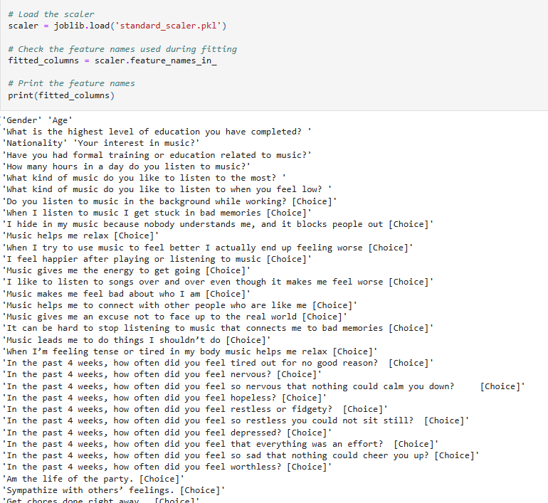
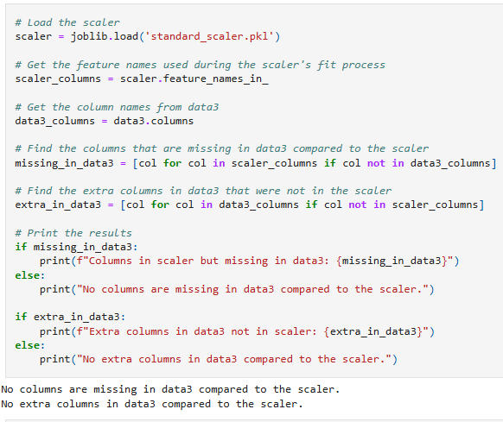
Working Module

Slide 11
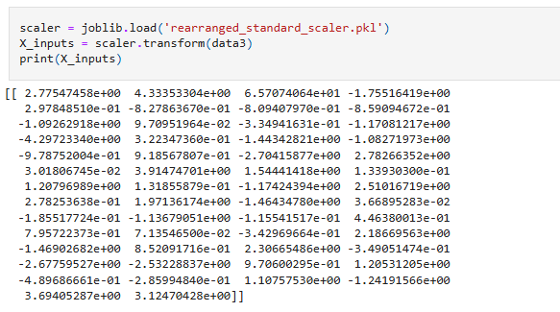
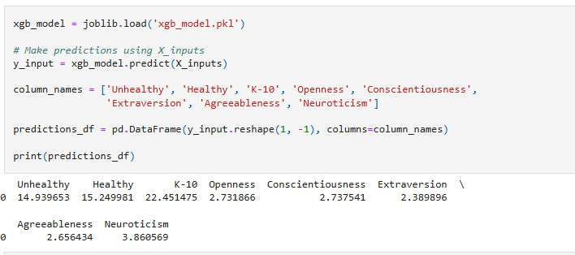
Working Module
Fig. 24

Slide 12
References
Rahman, J. S., Gedeon, T., Caldwell, S., Jones, R., & Jin, Z. (2021). Towards effective music therapy for mental health care using machine learning tools: Human affective reasoning and music genres. Journal of Artificial Intelligence and Soft Computing Research, 11(1), 5–20.
McFerran, K. S., Garrido, S., & Saarikallio, S. (2013). A critical interpretive synthesis of the literature linking music and adolescent mental health. Youth & Society, 45(4), 1–18.

Slide 13
Thank You

